Slide 1
Exercise App Using Kotlin
Submitted in the partial fulfillment for the award of the degree of
BACHELOR OF ENGINEERING
IN
COMPUTER SCIENCE & ENGINEERING
WITH SPECIALIZATION IN
MOBILE COMPUTING
Submitted by:
Anand Svarup Bhatia(19BCS4257) Utkarsh Chauhan(19BCS4270)
Shubham Mahajan(19BCS4275) Utkarsh Singh(19BCS4280)
Rishab Sharma(19BCS4290)
Under the Supervision of:
Ms. Rana Gill
Department of AIT-CSE
DISCOVER . LEARN . EMPOWER

Slide 2
Outline
Introduction
Literature Review
Problem Formulation
Objectives
Methodology
Results and Outputs
Conclusion
Future Scope
References

Slide 3
Introduction
Problem Definition: This problem will focus on daily routine of people and their busy lives. On how they can get enough time to work out while still not wasting most of their time and also maintaining their shape and their health properly.
Project Overview/Specifications:
The exercise app which is identical to 7 Minute workout will be implemented using Kotlin as the main language.
The app will help the user to stay fit and stay in shape despite of a busy day to day life.
Most of the common android features will be used like text to firebase, Recycle View.
The app will be connected to a Firebase database.
Adding the BMI calculator to the app.

Slide 4
Software Specifications:
4 GB RAM minimum, 8 GB RAM recommended.
2 GB of available disk space minimum, 4 GB Recommended (500 MB for IDE + 1.5 GB for Android SDK and emulator system image)
1280 x 800 minimum screen resolution.
Microsoft Windows 7/8/10 (32- or 64-bit). The Android Emulator supports 64-bit Windows only.

Slide 5
Windows requirements
Microsoft Windows 7/8/10 (32-bit or 64-bit)
3 GB RAM minimum, 8 GB RAM recommended (plus 1 GB for the Android Emulator)
2 GB of available disk space minimum, 4 GB recommended (500 MB for IDE plus 1.5 GB for Android SDK and emulator system image)
1280 x 800 minimum screen resolution.
Mac OS requirements
Mac OS X 10.10 (Yosemite) or higher, up to 10.13 (High Sierra)
3 GB RAM minimum, 8 GB RAM recommended (plus 1 GB for the Android Emulator)
2 GB of available disk space minimum, 4 GB recommended (500 MB for IDE plus 1.5 GB for Android SDK and emulator system image)
1280 x 800 minimum screen resolution.

Slide 6
Literature Review
Existing System: Thru detailed study conducted, few applications were studied and studies had following output:
Apps having equipment exercises which are not possible in current lockdown situation(Fig.1).
Apps had cluttered design (Fig. 2).
Apps were heavy and required internet access (Fig. 3).
Apps having ads and paid subscriptions (Fig. 4).
Apps giving advice to follow particular diet plan (Fig. 5).
The studies contained few of most popular apps:
Nike fitness +
Cult fit
Google fit
Adidas fitness
Healthify me.

Slide 7
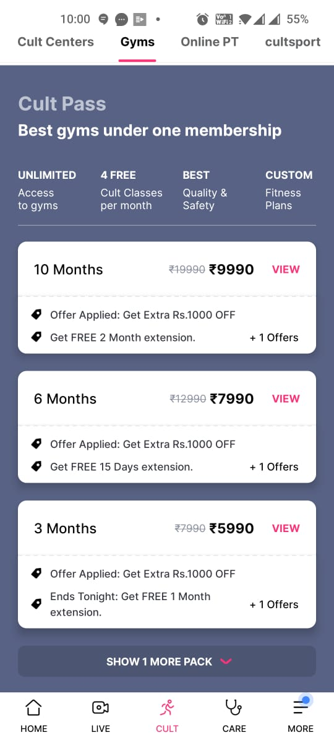
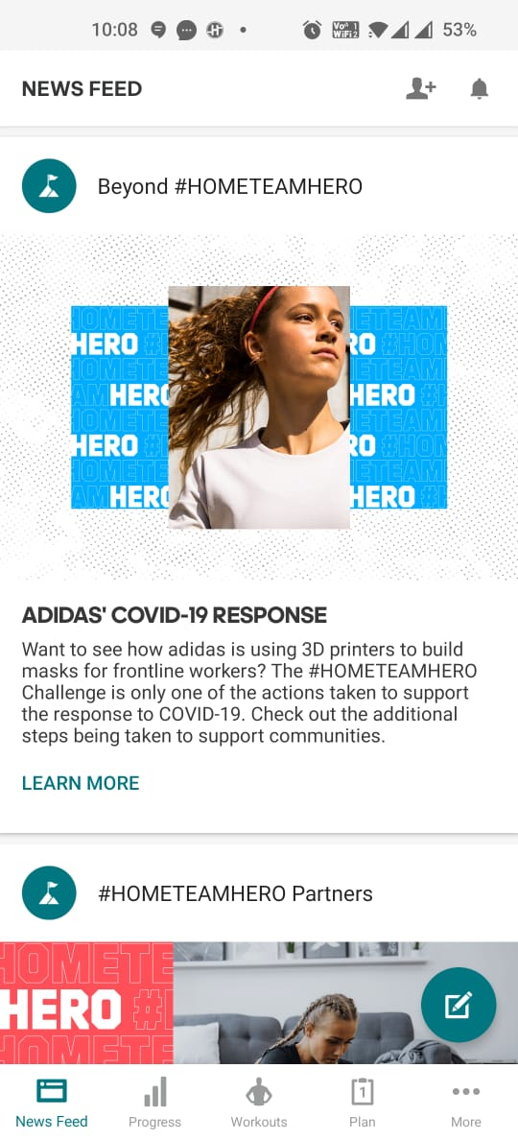
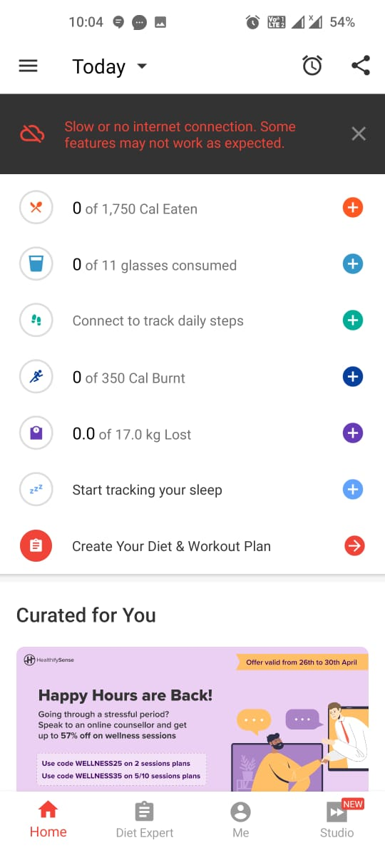
Fig. 1
Fig. 2
Fig. 3

Slide 8
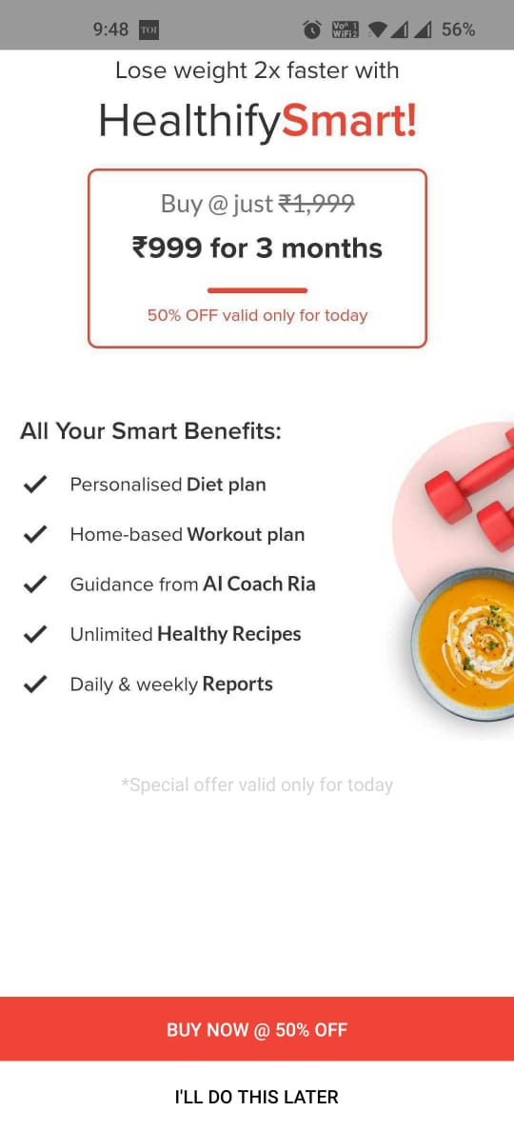
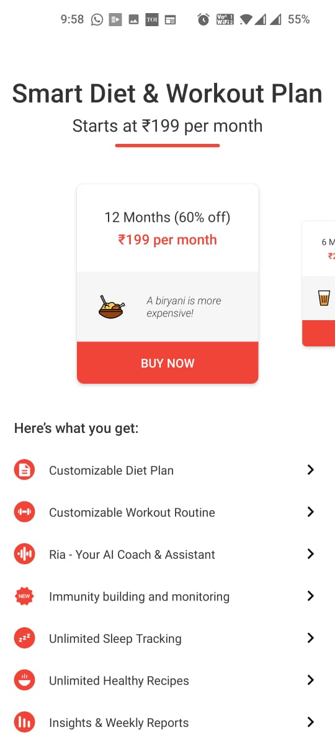
Fig. 4
Fig. 5

Slide 9
Proposed System: With proposed system, the cons of existing system were minimized and eliminated:
Full app content is offline.
App has a clutter-free and burdenless design.
App doesn’t have subscription model or any paid content.
No diet plan to be followed.
No equipment required.
These are some pictures of proposed system.

Slide 10
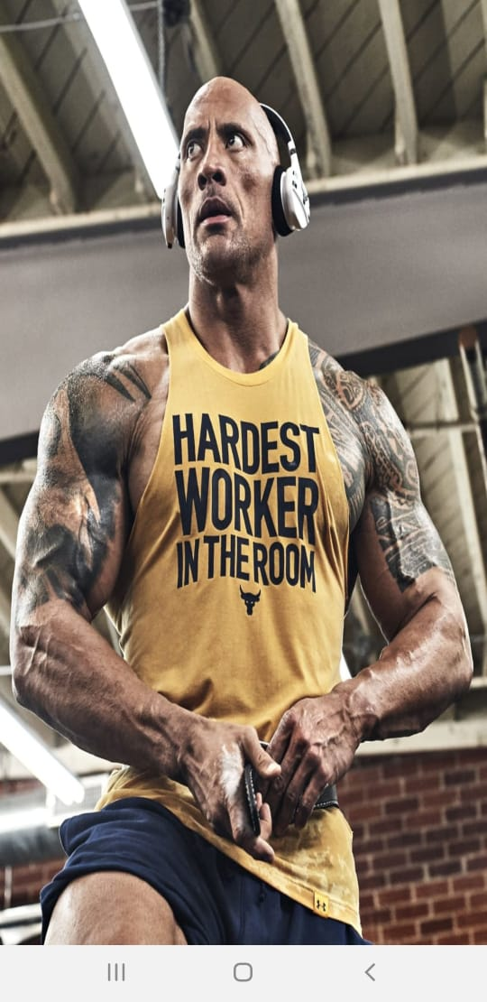
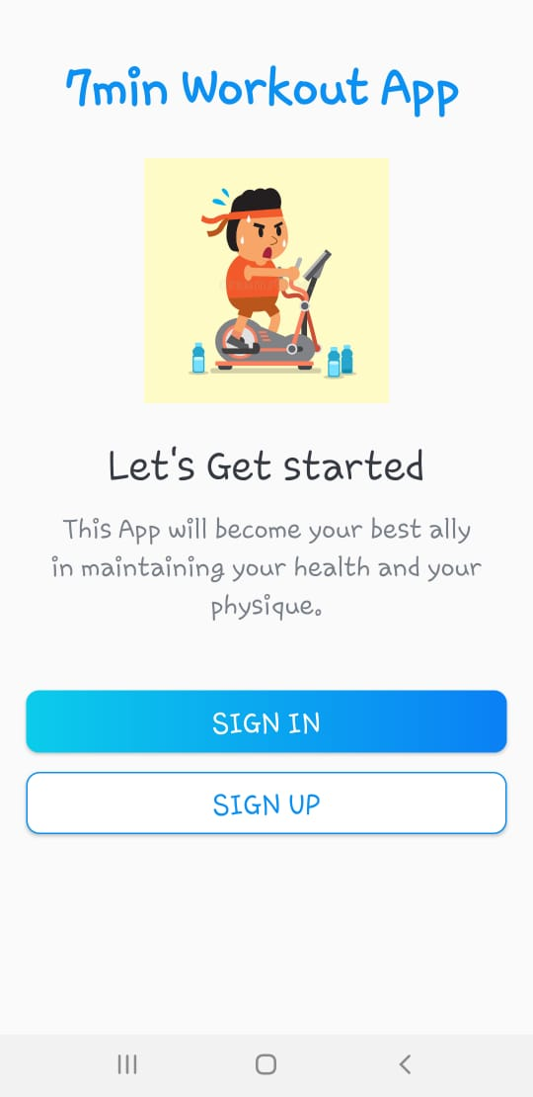
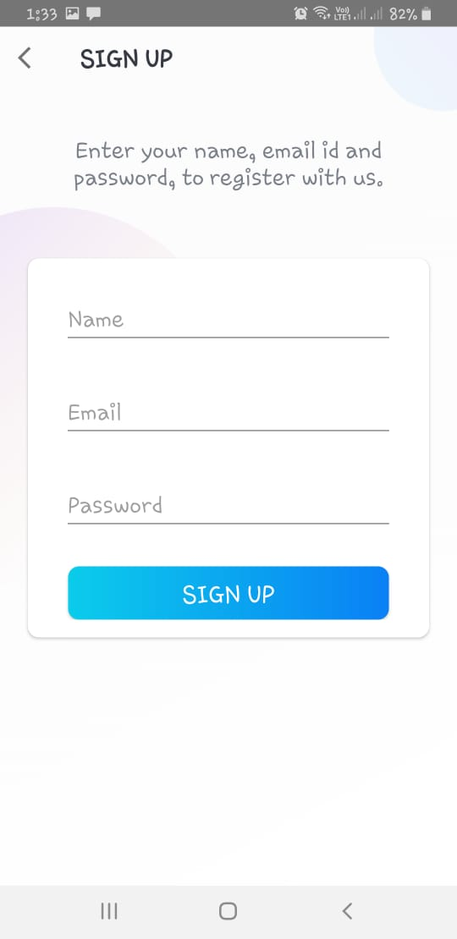
1. Home Page of App
2. Login Page of App
3. Sign Up Screen

Slide 11
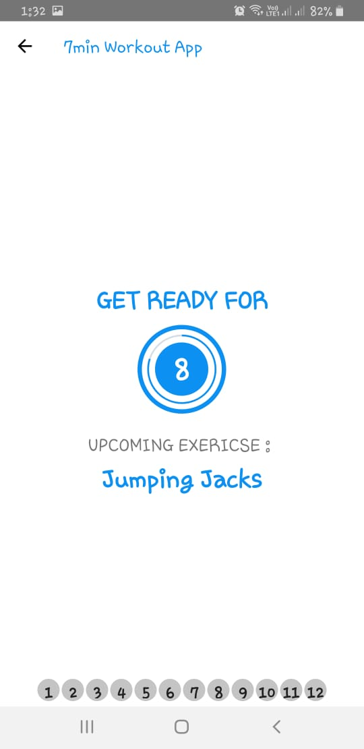
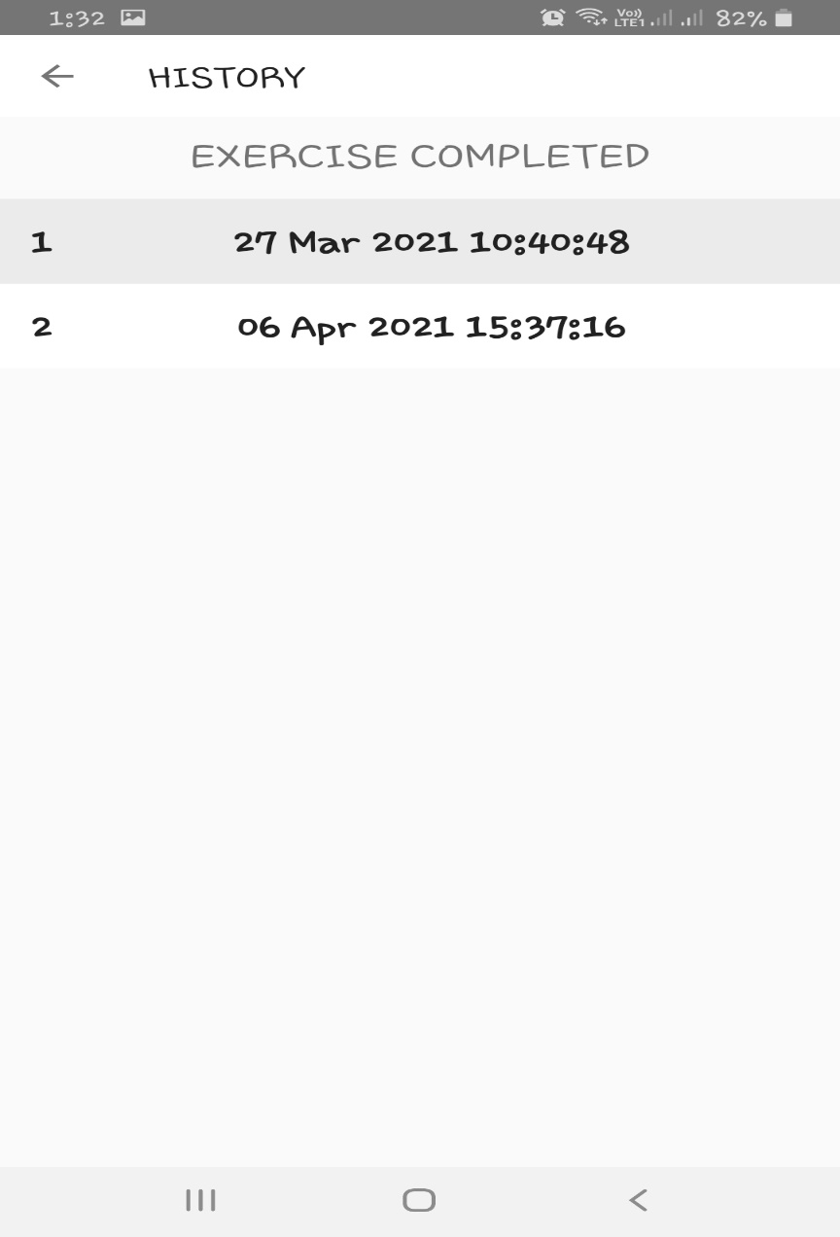
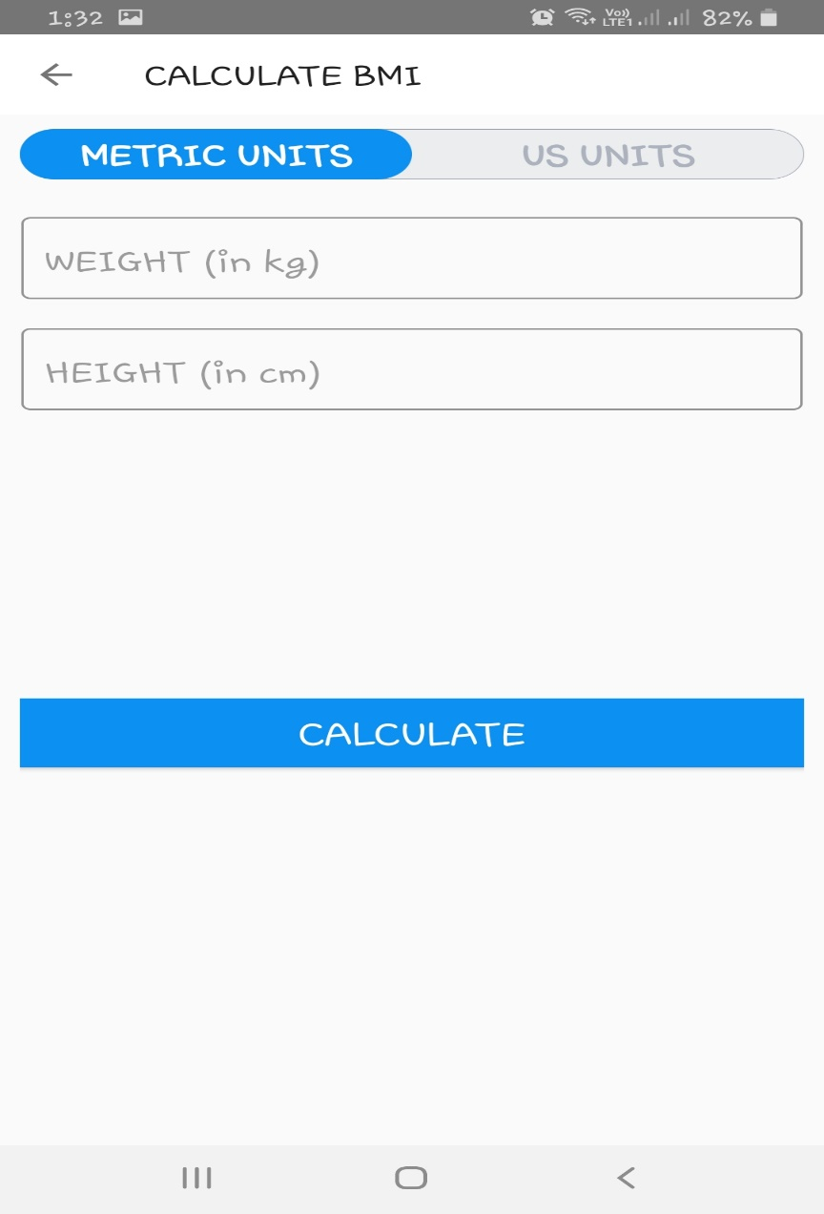
7. Ongoing Exercise of User
8. History of Exercise Completed by User
9. BMI Calculation Screen

Slide 12
Problem Formulation
During software development, The main problem with the existing app is that it deals with unnecessary exercise and focus too much on the UI which makes the app heavy and therefore it takes some time to launch on the device.
This app will not focus much on the UI but it will take into account what exercise is necessary i.e. which targets all the body muscles in proper proportions without the use of any outside tools like dumbbells, etc.
Also, this app will be very light and therefore it will not take up unnecessary memory of your android device. From the literature review, it is observed that studies highlight the need of efficient and time saving approach of the Exercise App Using Kotlin.

Slide 13
The existing apps are not able to cope up with the time management of those, who are not able to devote much time to the gym.
Different approaches suffer from :
Lack of time
Expensive solutions
Strict Food diet.
So firstly, there is a need of an app that works flexible as per the home Schedule of an individual and also that is more time saving and Absolutely Free. Second this app must be compare with the current Exercising Apps that are available on the Mobile platform and time: efficiency ratio should be calculated.

Slide 14
Objectives
The proposed research is aimed to carry out work leading to the development of an approach for the Exercise App using Kotlin.
The proposed aim will be achieved by dividing the work into following objectives:
1. Since majority of the people are not able to provide much of their time for gym, this app is fully flexible as per your own routine.
2. Also, even if you cannot give or devote much of your time on exercising, no need to worry about. This App will just take few minutes to get you all ready.
3. Unlike other apps, that are too confusing for the Non- techno friendly people, this app's interface is based on the design that is easy to use and is more interactive.
4. You specifically wouldn't need a particular diet plan, because this app doesn't make you to follow any specific diet plan.
5. Also, This app is doesn't require any payment methods, it is absolutely Free.

Slide 15
Methodology
The following methodology will be followed to achieve the objectives defined for proposed research work:
Detailed study of exercise apps will be done.
Installation and hand on experience on existing approaches of exercise apps will be done. Relative pros and cons will be identified.
Various parameters will be identified to evaluate the proposed system.
Comparison of new implemented approach with existing approaches will be done.
Feedback will be taken from research.
New ideas will be implemented to eliminate cons.

Slide 16
Results and Outputs
By implementing a basic UI and applying app smoothening the product turned out to be very light and easy to use.
The tester is satisfied with the workout and gives a very positive feedback.
Outputs of the App are on next slides.

Slide 17
1. Home Page of App
2. Login Page of App
3. Sign Up Screen

Slide 18
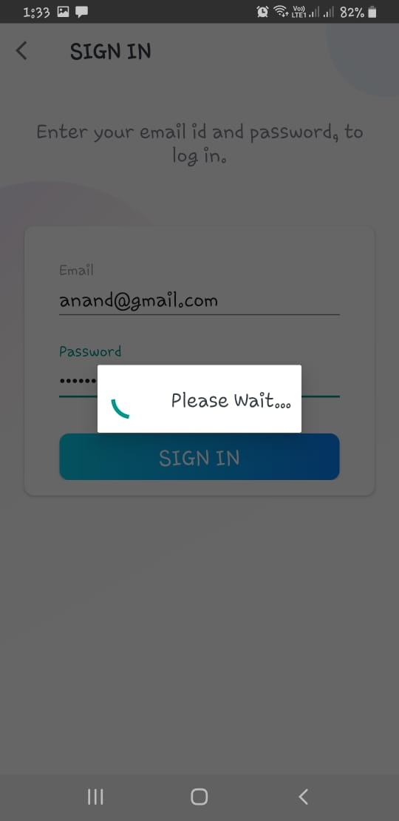
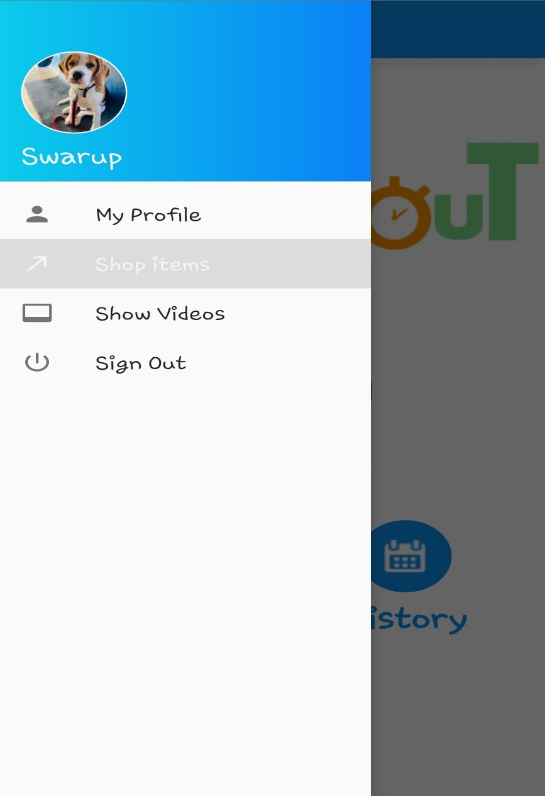
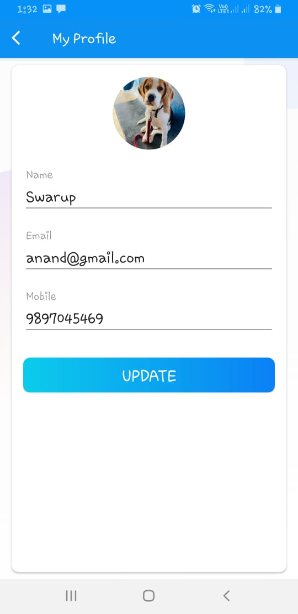
4. Sign In Screen
5. Menu of App
6. Here User can update his Profile

Slide 19
7. Ongoing Exercise of User
8. History of Exercise Completed by User
9. BMI Calculation Screen

Slide 20
Conclusion
As one can observe that the app is very much ready for daily exercises and beside that we can also add some new features like –
Excercise app using kotlin is a free - offline app for exercise.
It has a burdenless design.
It has all the basics features a person needs from an exercise app without any clutter.
It has built in fitness store to cater all your fitness needs.
It has video coaching with informative videos all free of cost so that you see and learn at comfort of your home.

Slide 21
Future Scope
The app can schedule diet for the users according to their daily routine.
The App can be automated using web scraping and ML to find specific exercise on the web for different BMI.

Slide 22
References
https://developer.android.com/guide
https://developer.android.com/codelabs/kotlin-android-training-available-resources/#2
https://developer.android.com/courses/android-basics-kotlin/course
https://developer.android.com/guide/topics/ui
https://github.com/BLANK00ANONYMOUS/7MinuteApp

